Slide 1
Deep Learning in GPUs using Limited Precision
Prepared By:
Chitrarth Singh(A20387080)
Pradyot Mayank(A20405826)
Navneet Goel(A20405197)

Slide 2
Contents
Abstract
Introduction
Literature Review
Problem Statement
Related Work
Proposed Solution
Evaluation
Conclusion/What we Learnt
References

Slide 3
Abstract
Numerical operations on GPUs are challenging in terms of accuracy, precision, and performance making it essential to choose the best representation of data.
We have created a model with limited precision data to train Deep Neural Networks on two benchmark datasets: MNIST floating point data format to enhance the performance and reduce the memory usage of neural networks running on GPUs.

Slide 4
Introduction
Deep learning (also known as deep structured learning or hierarchical learning) is part of a broader family of machine learning methods based on learning data representations, as opposed to task-specific algorithms. Learning can be supervised, semi supervised or unsupervised.
Deep learning architectures such as deep neural networks, deep belief networks and recurrent neural networks have been applied to fields including computer vision, speech recognition, NLP, audio recognition, social network filtering, where they have produced results comparable to and in some cases superior to human experts

Slide 5
Literature Review
High Precision Data formats consume relatively higher amount of memory and yield mediocre performance​​ as​​ opposed​​ to​​ limited ​​precision​​ data​​ format.
The half precision (FP16) Format is not new to GPUs. In fact, FP16 has been supported as a storage format for many years on NVIDIA GPUs, mostly used for reduced precision floating point texture storage and filtering and other special-purpose operations.
The Pascal GPU architecture implements general-purpose, IEEE 754 FP16 arithmetic. High performance FP16 is supported at full speed on TeslaP100 (GP100), and at lower throughput (similar to double precision) on other Pascal GPUs (GP102,GP104,​​and​​GP106).

Slide 6
Problem Statement
Applications today being data-intensive, generating huge datasets which requires faster computing and greater accuracy. CPUs and GPUs are exhausting in their potential to be at par in processing this kind of data.
High Precision Data Formats, as we already know, consumes significantly huge amount of memory space to achieve higher accuracy with great precision which reduces the performance of GPUs and system throughput overall .e.g. Neural network with supervised learning are rather meant to be more efficient ​​than ​​power ​​consuming.

Slide 7
Related Work
Research paper by Yoshua ​et al.​(2015) talk about training deep neural networks using low precision multiplication and achieving optimized memory usage on general purpose hardware.
Jordan ​et al.adapted limited precision calculations to train deep neural network for back propagation algorithms.
Guptaet al used 16- bit fixed point format to train neural networks on FPGA gaining significant amount of efficiency ​​and ​​computation​​ throughput.

Slide 8
Proposed Solution
We have implemented a deep neural network model using TensorFlow libraries on GPUs.
GPUs through their multi-core architecture provides enhanced throughput to train models/neural nets in deep neural network when compared to CPUs.
TensorFlow libraries automatically discovers and uses GPUs and ​​multiple​​ cores. Also,​​it​​ supports ​​seamless ​​quantization​ ​of​​ limited​​ precision ​​​​data​​types.
We have used two datasets for our model: MNIST
MNIST database of handwritten digits of 28x28 pixels which has a training set of ​60,000 examples, and a test set of ​10,000 examples.

Slide 9
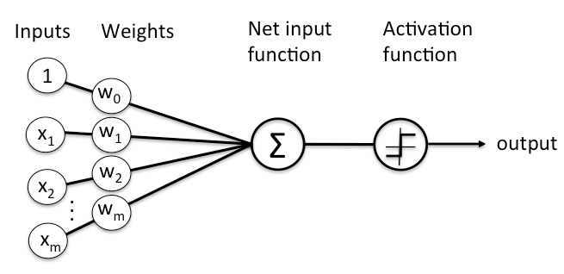

Slide 10
Evaluation
Accuracy vs. Epochs on CPU(FP64,FP32,FP16)
Accuracy vs. Time on CPU(FP4,FP32, FP16)

Slide 11


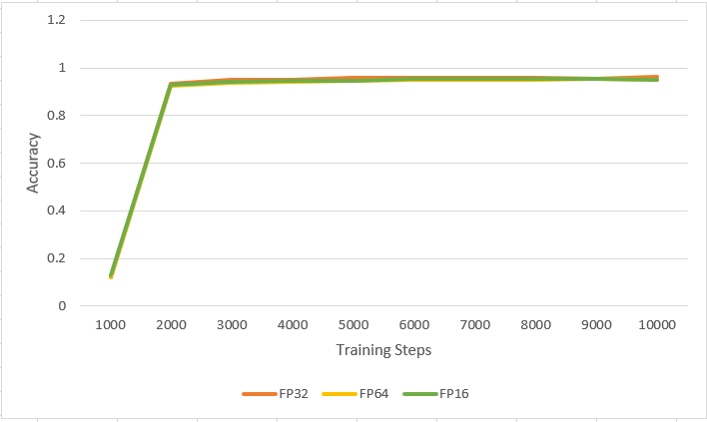
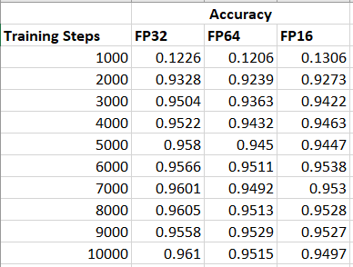



Training steps vs. Accuracy

Slide 12
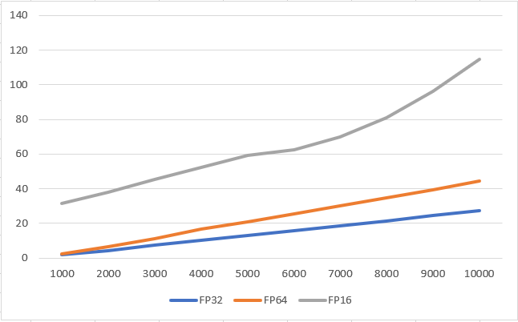
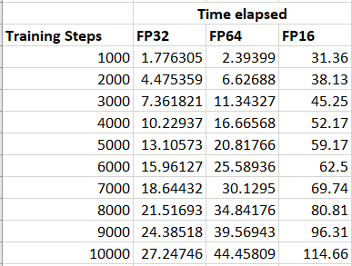
Training steps vs Time Elapsed

Slide 13
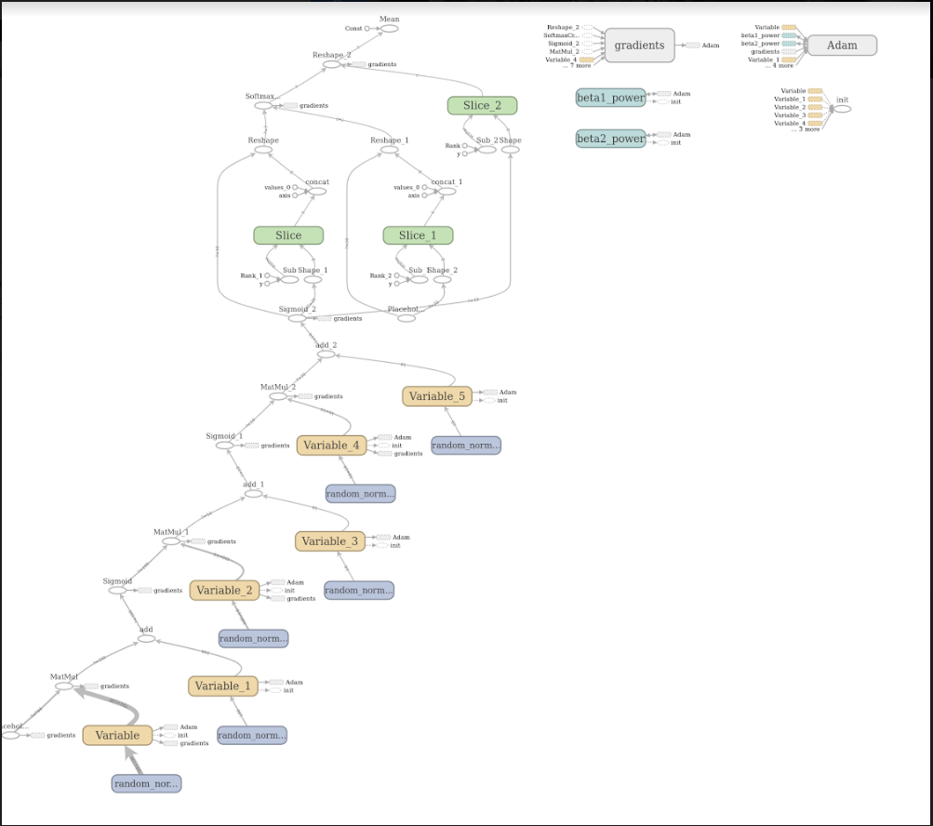
Graph generated on Tensor board

Slide 14
Conclusion/What We Learnt
Learnt how​ ​to ​​implement​​ deep​​ neural​​ networks​ ​efficiently with ​low​ ​precision.
M​ultipliers​​​​ are​ ​sufficient​ ​for ​​training ​​deep​​ neural​​ networks.
Using​​ a ​​higher ​​precision ​​for ​​the​ ​parameters​ during​ ​the ​​implementation​ ​helps​ ​for ​understanding​​ of ​​the​ ​model.
Our​​ work​​ can​​ be ​​exploited ​​to​​ optimize ​​memory​ usage​ on​ general-purpose​ hardware chameleon​ ​test bed​​ with ​​more​ ​than​​1​​GPU​​.)
Limited ​​precision ​​floating ​​formats ​​is ​​sufficient ​​for ​degradation ​​in​ ​the​​ accuracy​​of​​the​​final​​result.
Achieve ​​faster ​​computation​​on ​​GPUs​ ​using​ ​these​​ limited​​ precision​ ​data​​types.
Minimize ​​loss ​​of​​ information​​ when​​ quantizing​​ trained​ ​model​​ weights​ ​to ​​limited​ ​precision​ and​​ during ​​limited​ ​precision​​ computation​​ of​ ​activations

Slide 15
References
Presley, ​​R.​​K. ​​and​​ Haggard, ​​R.​​L. ​​(1994).​​​ A​​ fixed ​​point​ ​implementation ​​of ​​the ​​backpropagation learning​​ algorithm​. ​​In ​​Southeastcon’94. ​​Creative ​​Technology​​ Transfer-A​​ Global ​​Affair.,​​Proceedings​IEEE, ​​pages​​136–138.
IEEE.Holt,​​J.​​L. ​​and​​Baker,​​T.​​E.​​(1991). ​​​​​Back​​propagation ​​simulations​​ using ​​limited​ ​precision​ ​calculations.​​ In​​ Neural​​ Networks​, ​​1991.,​​ IJCNN-91-Seattle ​​International ​​Joint ​​Conference​​on​​,​​ volume​​2, ​​IEEE Courbariaux, M., ​Bengio, Y.,​David,​ J.P.:​ Training​ ​deep​​ neural​​ networks​ ​with​ ​low​ ​precision​​ multiplications. ​​​arXiv ​preprint.
Gupta, ​​Suyog, ​​Agrawal, ​​Ankur,​​Gopalakrishnan, ​​Kailash, ​​and ​​Narayanan plearning ​​with ​​limited, ​numerical​​​​precision​.​​arXiv​​​​ preprint ​​​​arXiv:1502.02551​​,2015. Devblogs ​​nvidia: ​​​Mixed-Precision​ ​Programming​​ with​​ CUDA​​8 Tensorflow:​​ ​Quantizing​ ​Neural ​​Networks​ ​with​​ Tensorflow.

Slide 16

Q & A

Slide 17
THANK YOU

